Slide 1

My Advanced Programming Final
By: Jeremy D. Whitenect

Slide 2
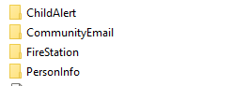
Thought Process
We had to do at least four APIs, so that’s what I went with
I thought about having them all be in the same project since all of the APIs I picked used a person controller and model
I ended up deciding against this, however, as it made my code, and database schemas much easier to understand at a glance.

Slide 3
API 1: Fire Station API
All of the APIs are relatively similar, so the Fire Station was the hardest since I did it first and is only one of two APIs to use a service class.
Although not being a requirement, I did add all four Get, Post, Put and Delete mappings for every controller for ease of testing.
I also added a test class for every controller to test adding People, FireStations, etc.
The service class simply gets all people by their fire station and adds on the number of minors and adults.
I used a many to one relationship since a fire station can serve many people, but if you’re a person in one area, you’re probably only going to be served by one fire station

Slide 4

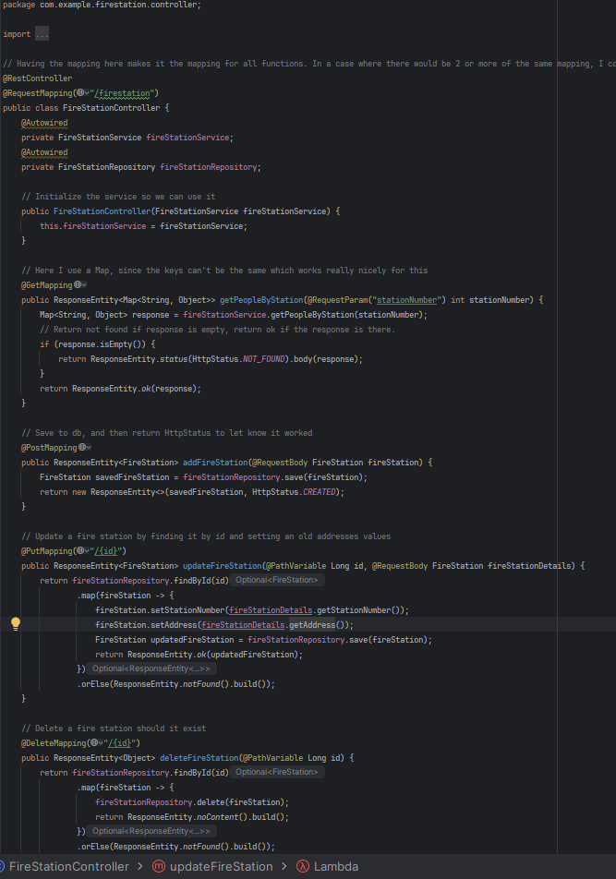
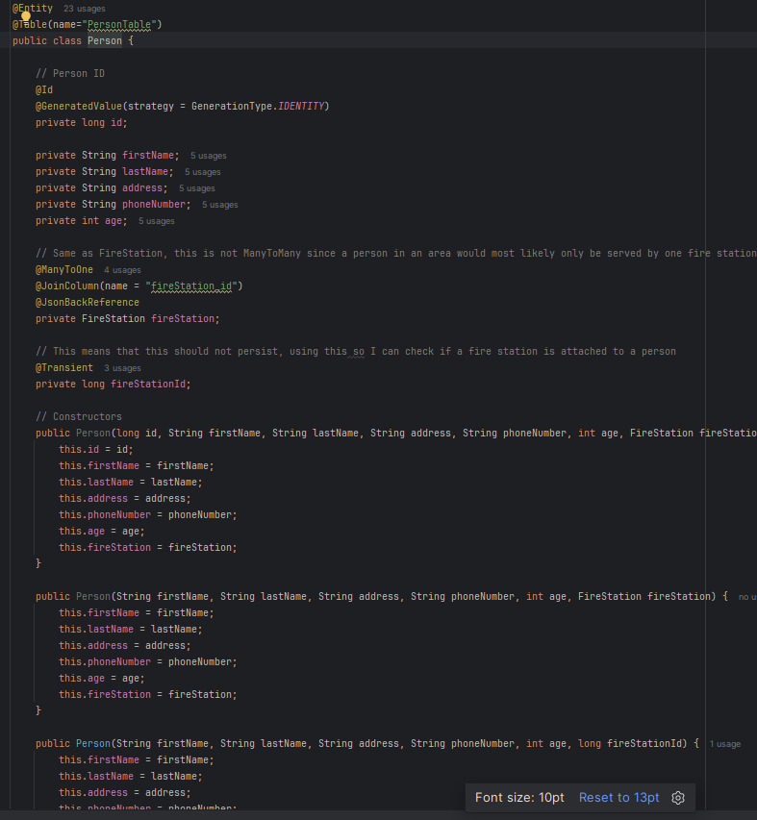




Controller & Entity

Slide 5
API 2: Child Alert API
This is the most similar to the Fire Station API.
There is a person and and now a separate address controller and entity.
The main goal of this one was to get all people at an address who are minors.
This was not necessarily something a built in JPA method could do on its own, so I had to make a service.
I also made a service interface to align more with OOP and SOLID (we’ll get to that at the end)
My Address class has two parameters (aside from ID), a List of Person and a String address. And a person has an Address.
This meant that, in the service, I could use the built in JPA method “findByAddressAddress” (from PersonRepository) and then filter out the data by age.

Slide 6
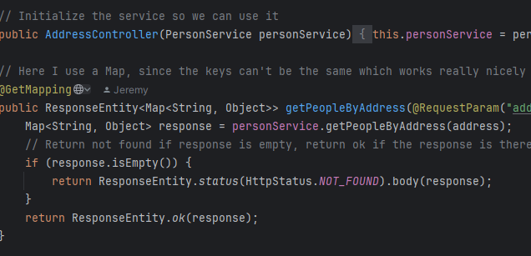
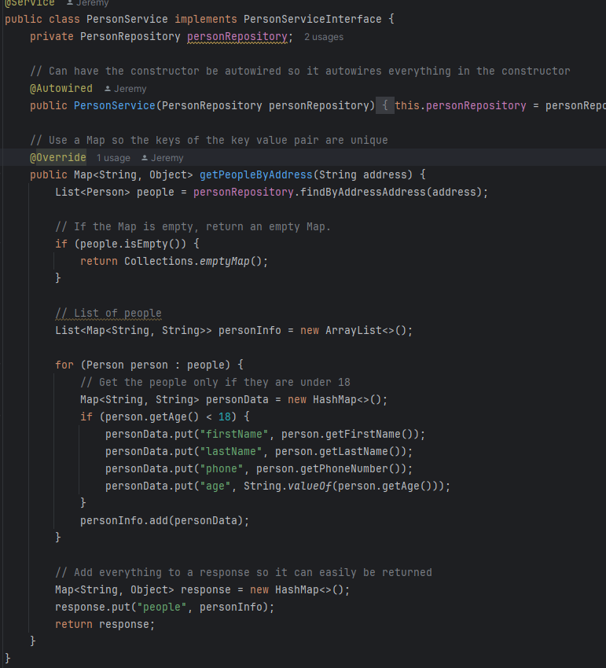
Controller & Service

Slide 7
API 3: Person Info
Like the previous, this is still similar to the Fire Station API, but still much less so.
This time, there’s a Person and Medication.
Sounds similar, unlike the last two, this is a many to many relationship instead of many to one.
I used @JsonBackReference and @JsonManagedRefenence to avoid recursion for the others, so I had to use @JsonIgnore for this one.
Since Medication is just name and dosage, I made it so that if you post a Person with their medication list, it creates the medications if they’re not already in the table.
I also make sure to remove all people from a medication list when they are deleted.

Slide 8
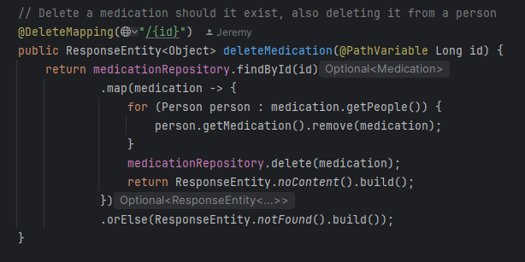
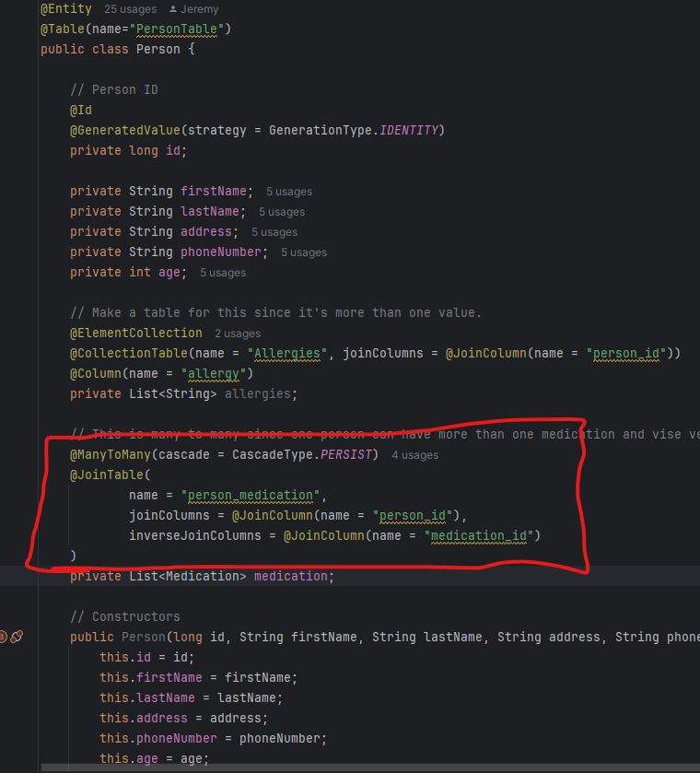
Entity & Controller

Slide 9
API 4: Community Email
For this one, it was to get the email of all people in a city.
I decided to just get all the information of the people in a city to keep some consistency between my other 3 APIs.
This time I can do findByCityName without making a separate service since no data needs to be filtered out.
Other than that, there’s the other Post, Put and Delete mappings like the others, as well as the tests.

Slide 10
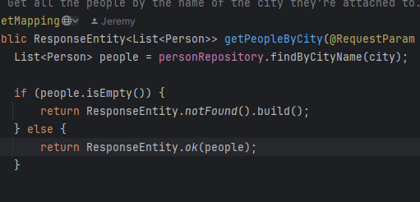
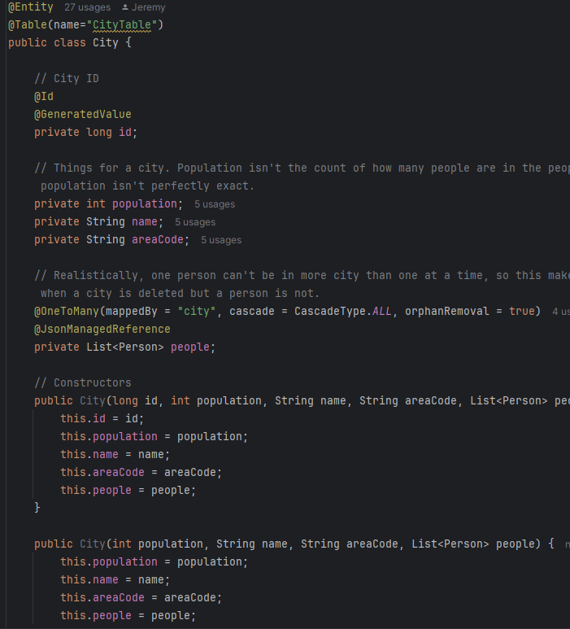
Entity & Controller

Slide 11
